Slide 1


AugmentIQ – L&T Discussion & Demo
April 2016
© Copyright 2013-16 augmentIQ Data Sciences

Slide 2

Agenda
Introduction
Platform Details
Overview & Use-cases
Technology Architecture
Competitive Analysis
Next in roadmap
Demonstrations
Platform
Solutions
Discussion
© Copyright 2013-16 augmentIQ Data Sciences

Slide 3
About Us: Introduction
FOUNDED IN
December 2012,
Pune, India.
WHAT WE DO
Big Data technologies and analytics.
Provide a fastest to maximize ROI on Big Data.
A suite of Self-service platform, Accelerators & Pre-built Solutions – on-premise of on-cloud or hybrid.
PURPOSE
Provide a fastest way to Enterprise Intelligence:
“Relevant Data, Computing Technology, Analytics & Value-delivery”
SUITE / OFFERING
Platform:
MaxIQ: Enterprise Intelligence platform
Solutions:
IdentIQ: Entity resolution / de-duplication solution
EngagIQ: Customer engagement & analytics
*MosaIQ: 360 degree view & real-time engagement
© Copyright 2013-16 augmentIQ Data Sciences

Slide 4
MAXIQ suite:
Enterprise Intelligence Platform & Solutions
Automation approach to leverage Big Data technologies
Start immediately with internal & external data
All types of data, at any scale
Re-use skills, analytical assets
+
Our pre-integrated solution for specific verticals & departments
© Copyright 2013-16 augmentIQ Data Sciences

Slide 5









AugmentIQ’s complete automation approach to Big Data
Data
2
A suite of vertical Solutions
1
Value delivery & consumption
Big Data Analytics Platform
Infrastructure – On-premise or on-cloud
© Copyright 2013-16 augmentIQ Data Sciences

Slide 6
1
Platform: MAXIQ | Enterprise Intelligence Platform
Data
Extensibility for specific customizations
Pre-built Data
Access & connectors
Value delivery & consumption
Self-Service Analytics:
Design & high performance execution
Infrastructure – On-premise or on-cloud
© Copyright 2013-16 augmentIQ Data Sciences

Slide 7
Platform: Key components
There are 4 key components:
A pre-built, unified platform for simplified data sciences:
A self-service approach for advanced technologies such as Hadoop, Spark et al.
Enabling teams to do Big Data : volumes, unstructured data, streaming data & Machine learning.
Extensibility for specific customizations:
SDKs for specific data mining & data processing.
Enabling existing teams (skills) to take charge of Big Data technology adoption.
Pre-built data access & collection (ongoing):
Connectors to all (over 200+) sources & formats (files, large volumes, streaming & real-time).
Internal data, Data on SaaS platforms, external data.
Flexibility in choice of infrastructure:
To be on-cloud, on-premise or hybrid.
© Copyright 2013-16 augmentIQ Data Sciences

Slide 8
Platform: Key use-cases for enterprises
On-cloud or On-premise
Ad-hoc analysis on large scale data using Hadoop & Spark
Enterprise Analytics platform: Data integration, Data-flows & complex operational analytics
Data integration & Fusion platform
(Internal - External, Structured-Unstructured, Batch-Streaming)
Agile / Elastic Data warehouse on Big Data technologies
Monitoring & event driven analytical processes
© Copyright 2013-16 augmentIQ Data Sciences

Slide 9

MAXIQ Platform Overview
Proposals
Leads, Quotes
MAXIQ - PLATFORM
Customer Data silos
CRMs, Multiple Systems
Extract Entities from Unstructured Data & Connect the dots
Open Architecture: Extend & integrate existing / any 3rd party Analytics modules
Transactions History
Sales & Services
Enrich
& Link
Extend
Machine Generated
Sensors, Logs
Enrich
Customer Interactions
Emails, Calls, Support Tickets
Ingest
Data Analytics
Explore
Enterprise Intelligence Solutions
Ingest Anything (Structured & Unstructured)
Immediate
visibility into Everything
Social Media
Posts, Tweets, Reviews
Web Channel
Clickstreams
Built for Scale
Mobile Channel
Geo-locations
Leveraging best breed technologies
Hadoop, Spark, Kafka, HBASE, Elastic
External Repositories
Bureaus, Registries
© Copyright 2013-16 augmentIQ Data Sciences

Slide 10
Summary: Value proposition to enterprises
Benefits to enterprises
1
AUTOMATION: FASTER
TIME TO ADOPT
(In weeks than months)
MaxIQ Suite provides a fastest way to Enterprise Intelligence:
“Relevant Data, Computing Technology, Analytics & Value-delivery”
2
SIMPLIFIED TECHNOLOGY RE-USE SKILLS, RESOURCES
3
REDUCED COST: AUTOMATION & CLOUD
4
RAPID INNOVATION CYCLES FOR DATA PRODUCTS
5
FLEXIBILITY TO EASILY CUSTOMIZE
© Copyright 2013-16 augmentIQ Data Sciences

Slide 11
MaxIQ Platform Architecture
© Copyright 2013-16 augmentIQ Data Sciences

Slide 12
MaxIQ Platform: Functional modules
MAXIQ Platform
Design UI:
Self-service design of Data sources & definitions, Apps, Schedule, Data profiling.
Operations UI:
Monitoring, Alerts for all processing (Data Ingestion, DAG and App Processing)
Security, Authentication & Authorizations
(LDAP)
Data
Exploration:
Profiling,
SQL,
MLLib,
Visualization
Data Connectors & Ingestion
Processing (Execution & Monitoring)
Data Ingestion and Spark Workflow Manager & Job controller, Logging & Monitoring
User Management
Extensions registry
Operational Security
Resource Management
Metadata Management
SDK : development of Extensions (MapReduce, Spark, Java)
SEARCH APPLICATIONS
STREAMING DATA ANALYTICS
‘R’ INTEGRATION
© Copyright 2013-16 augmentIQ Data Sciences

Slide 13
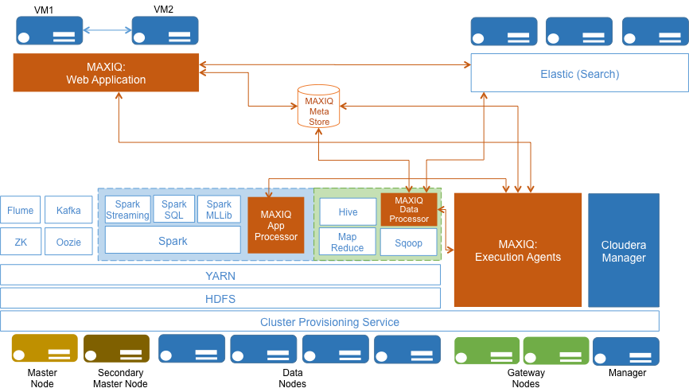
MaxIQ Platform: Logical architecture
© Copyright 2013-16 augmentIQ Data Sciences

Slide 14
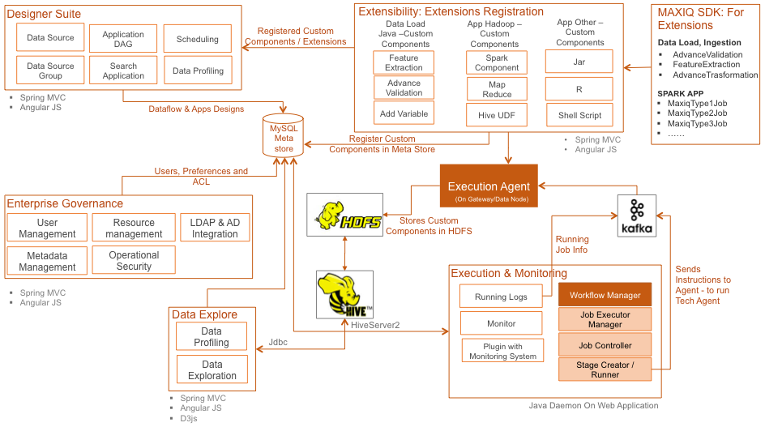
MaxIQ Platform: Logical architecture
© Copyright 2013-16 augmentIQ Data Sciences

Slide 15
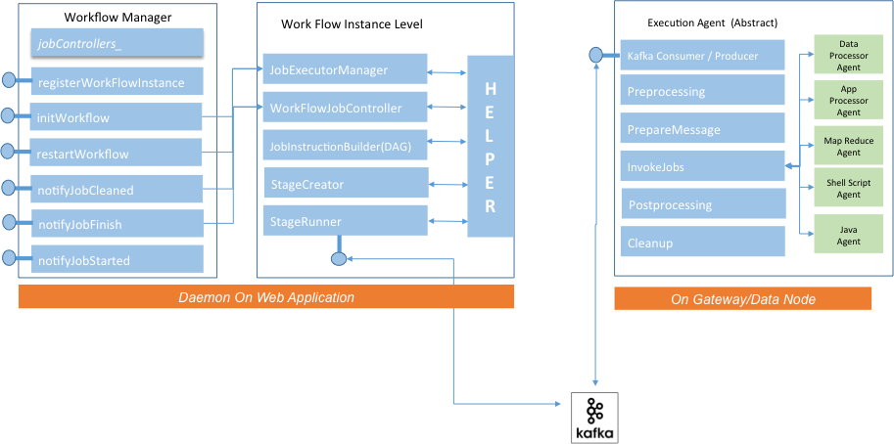
MaxIQ Platform: Workflow manager & Execution Agents
© Copyright 2013-16 augmentIQ Data Sciences

Slide 16
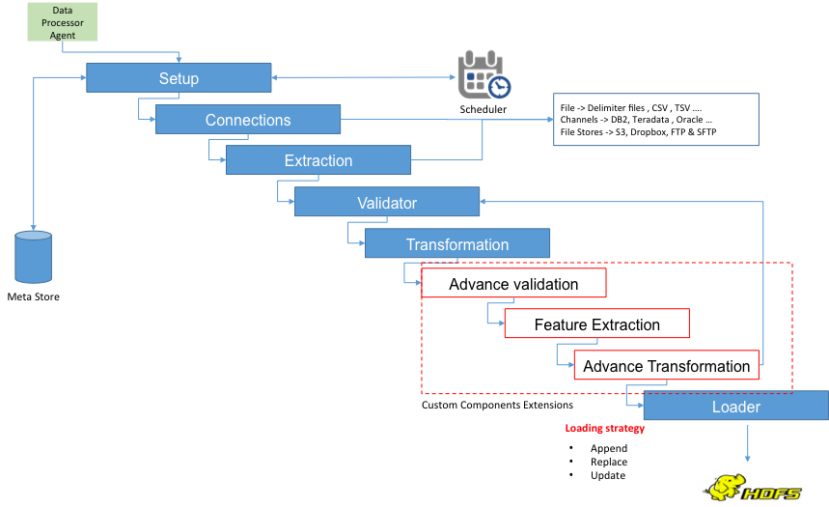
MaxIQ Platform: Data processing Agents
© Copyright 2013-16 augmentIQ Data Sciences

Slide 17
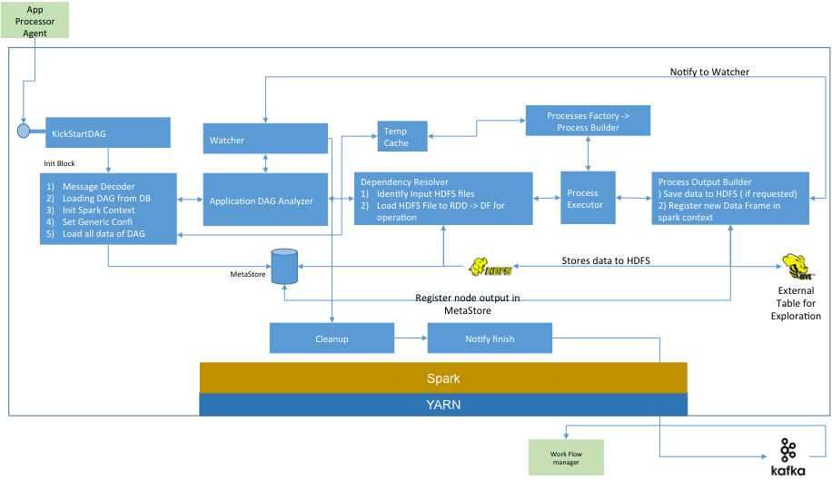
MaxIQ Platform: App processing Agents
© Copyright 2013-16 augmentIQ Data Sciences

Slide 18
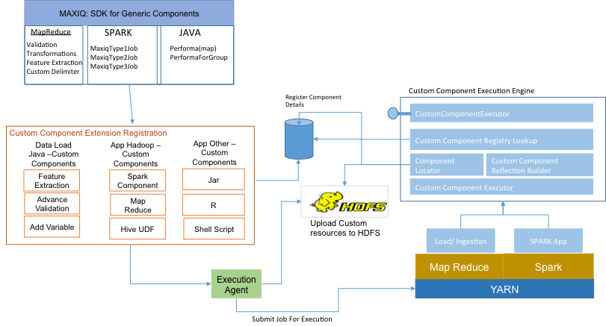
MaxIQ Platform: Extensibility
© Copyright 2013-16 augmentIQ Data Sciences

Slide 19
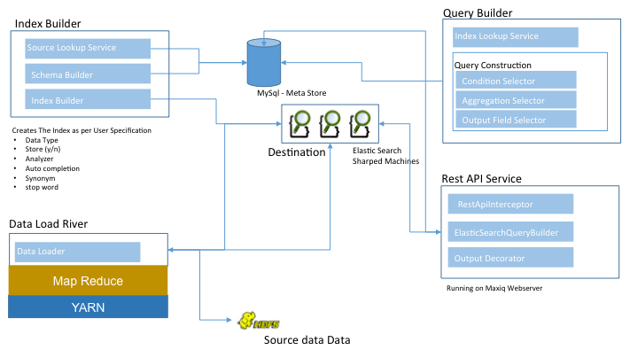
MaxIQ Platform: search applications
© Copyright 2013-16 augmentIQ Data Sciences

Slide 20
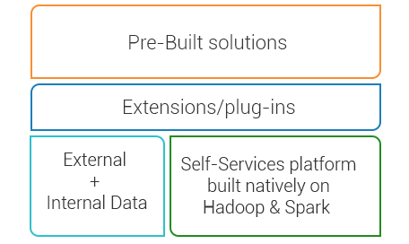
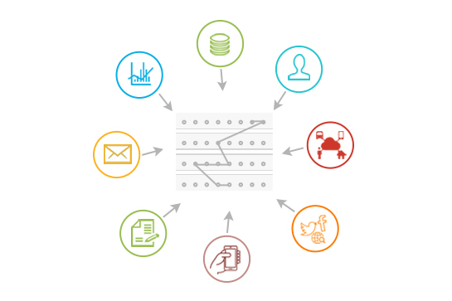
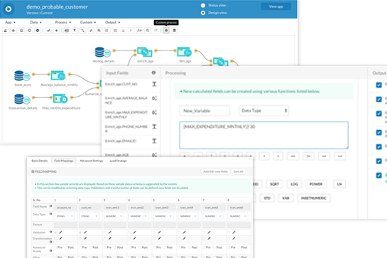
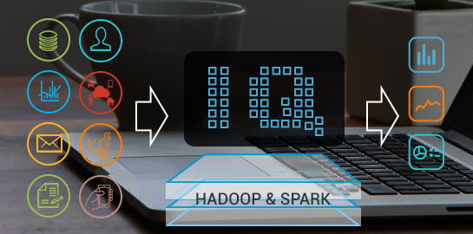
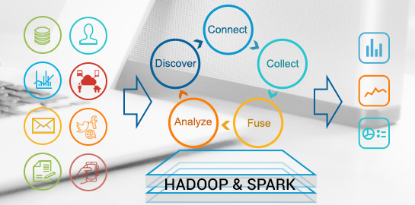
MAXIQ Platform: Key value propositions
Re-use existing teams & skills: Automation + Flexibility
Reduced Complexity in managing Big Data
DIY Simplicity:
Drag & Drop + extensibility
Intelligent Processing:
Right technology for right job & data
End-to-end Platform
Connect > Collect > Prepare > Analyze > Consume
© Copyright 2013-16 augmentIQ Data Sciences

Slide 21
Competitive Analysis – on value proposition
Similar
Capability
We are
currently better
We are still
catching up
We are
inherently better
Feature not available yet
MAXIQ FEATURES / OFFERING | DATAMEER | PLATFORA | IIP
Data Integration: Out-of-box connectors (ingestion & consumption)
Enterprise grade data management
Business users’ ad-hoc analysis
Enterprise scale & complexity of operational analytics
Integrated feature for Big Data ‘Search’
Data Visualization
Pre-built Industry Solutions & Analytics Apps
Time to market for new analytics apps
On-cloud Offering
Analytics Apps & Data : Self-service designs
Analytics Functions / Modules
Extensibility / Usability
Under-the-hood: Technology, intelligence & Enterprise grade Governance
Machine Learning & Data Sciences
?
© Copyright 2013-16 augmentIQ Data Sciences

Slide 22
MaxIQ Platform: next up (immediate)
1 month
3 months
6 months
User management & access control integration
HBASE as a data-store & interactive reads
Dataflow to Elastic - Kibana
Bug fixes
Multi-tenancy – on same cluster
Integration with Azure cloud for auto-provisioning
External / functional data connectors & access framework
Performance Improvement in DAG processing
Bug Fixes
Streaming data processing
Extension framework (data transformation, mining)
(Preliminary) Visualization
Downstream integration:
- Databases & stores
- Visualization
- Data Sciences work-flow (H2O or other)
Data security & governance
© Copyright 2013-16 augmentIQ Data Sciences

Slide 23
Case Studies – MaxIQ Platform
© Copyright 2013-16 augmentIQ Data Sciences

Slide 24
Credit Bureau client adopts Big Data for massive scale data-products within 8 weeks.
One of the many datasets was more than 1Billion records
A complex analytics process to deliver products at large scale
© Copyright 2013-16 augmentIQ Data Sciences

Slide 25
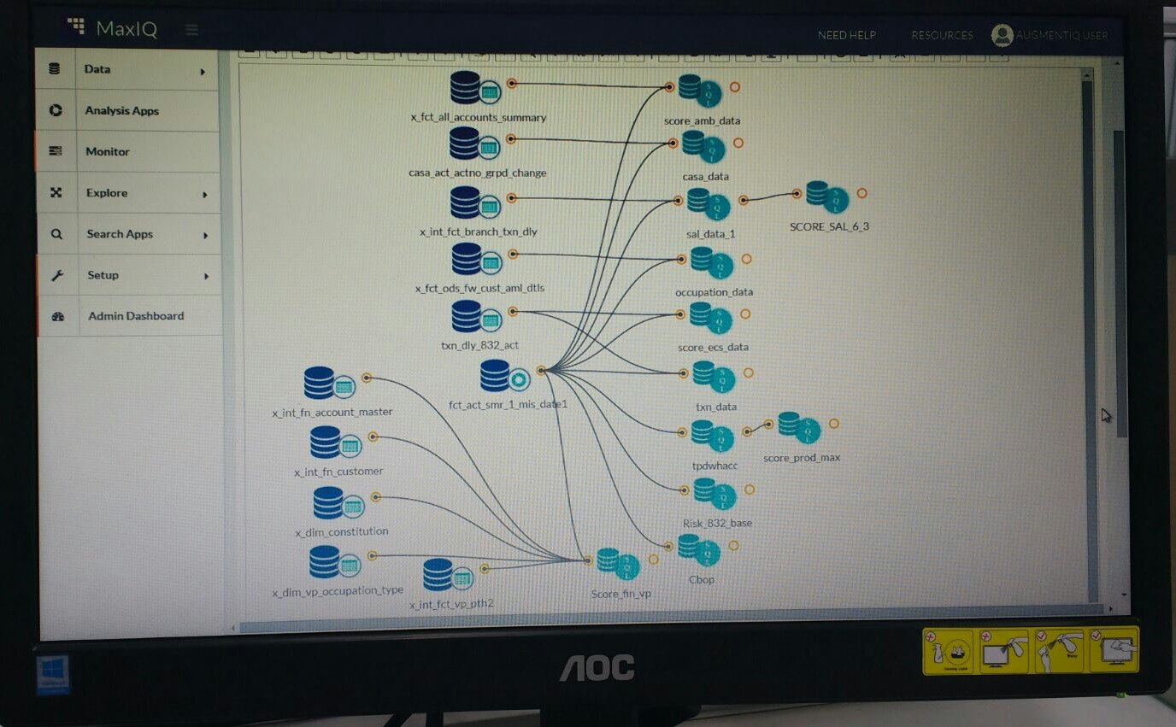
Banking client goes on Big Data technology with their cross-sell & up-sell Analytics within 10 weeks.
33 Data sources
27 million customers
2.5 billion records
A system of complex repeatable analytical processes - to drive regular cross-sell and up-sell campaigns.
Leveraged our platform
For large scale data fusion
Design & execution of Analytics Processes
Deliver end-value faster.
Now, they release campaigns in hours and not in weeks.
Started to iterate over new data > new value.
© Copyright 2013-16 augmentIQ Data Sciences

Slide 26
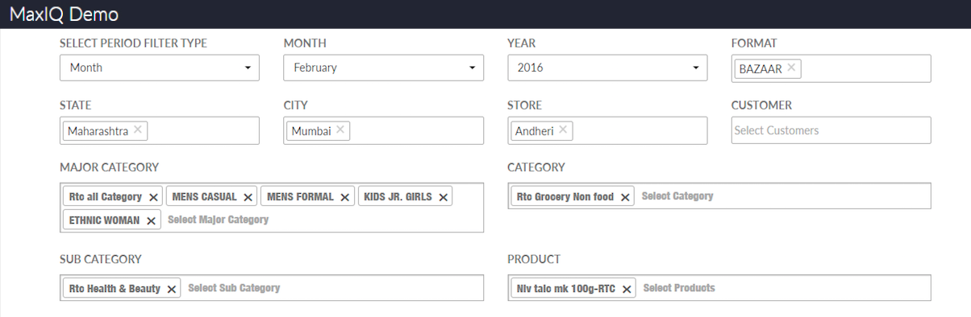
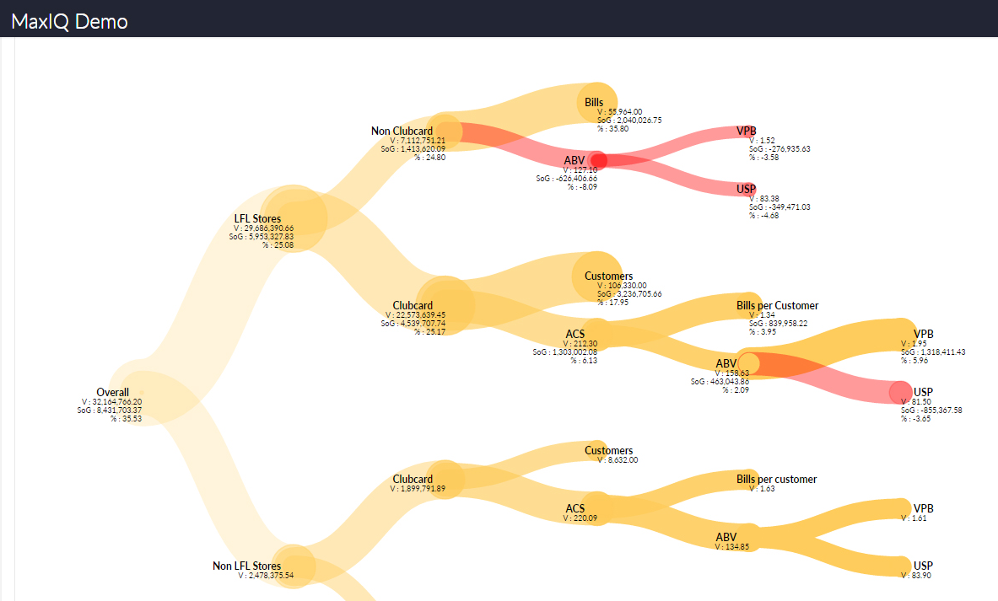
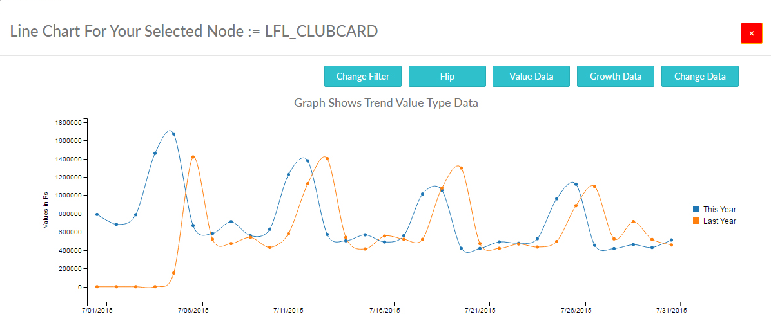
Retailer’s offline stores analytics POC delivered on cloud, from data to outcome: in 2 weeks.
40 million retail transactional data with various attributes
Problem discovery solution based on multiple hypotheses
© Copyright 2013-16 augmentIQ Data Sciences

Slide 27
2
Pre-built Solutions on Platform: AugmentIQ focus areas
Data
KYC, (Credit) Risk & Monitoring
Customer Experience Analytics
Intelligence Backbone for IOT
Horizontal Solutions & Accelerators
1
Value delivery & consumption
MAXIQ
Infrastructure – On-premise or on-cloud
© Copyright 2013-16 augmentIQ Data Sciences

Slide 28
2
Pre-built Solutions on Platform: focus areas
Single View of Customer & Real-time engagement
Customer-product affinity & real-time recommendations
Data Monetization: Real-time data exchange / enrichment - across data sharing entities
Monitoring & Alert systems
Streaming Analytics & pattern aberrations
Data Monetization: Real-time data exchange / enrichment - across data sharing entities
Consumer Risk Data mart & Analytics
Early Warning : For commercial lending using external data
Non-traditional Credit Risk Score
KYC, (Credit) Risk & Monitoring
Customer Experience
Intelligence Backbone for IOT
Horizontal Solutions & Accelerators
IDENTIQ: Advanced Entity Resolution (de-duplication of customer records from multiple source)
Entity Search: fuzzy & phonetic search for customer or commercial entities
Information Extraction: contextual information mining from email text
© Copyright 2013-16 augmentIQ Data Sciences

Slide 29
Demonstrations
MaxIQ Platform
MaxIQ Sample solutions
© Copyright 2013-16 augmentIQ Data Sciences

Slide 30
THANK YOU
© Copyright 2013-16 augmentIQ Data Sciences

Slide 31



Pre-built accelerator: IdentIQ
Deep entity (customer, business, product) resolution / de-duplication: Across silos of datasets
Internal Data Silo 1
Same Customers
Most
advanced
fuzzy,
Phonetics & affine algorithms
Internal Data Silo 2
House-hold
Unique
External Data
“IdentIQ”
Deep
priori
knowledge – regional nuances in Identity data
High Performance
Technology
Stack
Integrated view of Customer Data
Fragmented View of Customer Data
SPARK
© Copyright 2013-16 augmentIQ Data Sciences

Slide 32
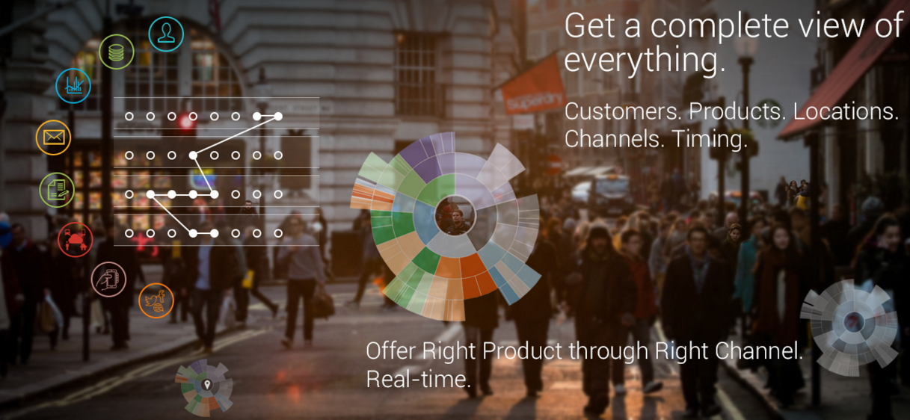
Pre-built solution: MosaIQ
360 degree view
For each customer > Delivering real-time relevant engagement
For Product & Channel > Delivering operational intelligence.
© Copyright 2013-16 augmentIQ Data Sciences

Slide 33
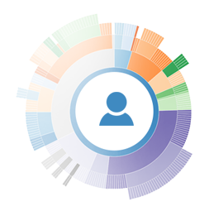


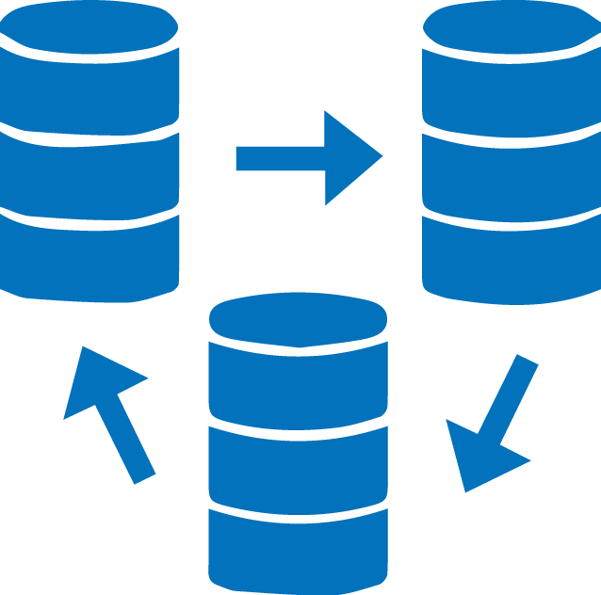

Use-cases for Enterprise Intelligence Solutions
Operational Efficiency & Real time analytics
Customer Experience through deeper Analytics
Internet-of-things & streaming data processing
Ad-hoc analysis by Business analyst
Processing large volumes batch & streaming data.
Structured data & un-structured data.
Complimenting data ware-house for operational processes.
Leveraging as data ware-house technology.
360 degree view of customer.
Real-time personalized engagement & Cross-sell and up-sell.
Regular operational analytics & reporting off customer data.
Predictive analytics on household/consumer.
Collecting external data.
Mining structure from unstructured data
Large scale data cleansing, transformation.
Fusion with internal data.
Performing ad-hoc analysis.
Streaming data analytics.
Intelligence across data points from connected devices.
Pattern recognition & aberrations.
Enabling data monetization across ecosystem.
© Copyright 2013-16 augmentIQ Data Sciences

